Slide 1

Analysis of Student Data to Determine Statistical Significance of Standardized Test Scores as Predictor of College GPA Lisa SiefKer GTDA 5626 | SP25
Notes:
Good afternoon. My name is Lisa Siefker, and today I will walk through an analysis of student data to determine whether standardized test scores are a significant predictor of college GPA.

Slide 2
AGENDA
Introduction
Methods
Results
Discussion
Notes:
I will provide some background and explain why this analysis is relevant and important. Then I will walk through the analysis and results. Lastly, I will provide suggestions for further research and analysis.

Slide 3

INTRODUCTION Colleges across the U.S. are considering updating pandemic era test-optional admissions policies. However, experts continue to debate the usefulness and equity of considering standardized test scores in college admissions decisions¹.
image source: https://www.studyusa.com/en/a/1284/what-is-a-standardized-test
¹Leonhardt, D. (2024, January 7). The Misguided War on the SAT. New York Times.
Notes:
As background, colleges had implemented test-optional admissions policies in response to the Covid-19 pandemic because students were not able to gather to take the SAT and ACT. Now that the pandemic has subsided, colleges across the U.S. are considering returning to mandatory test policies.
However, experts continue to debate the usefulness and equity of considering standardized test scores in college admissions decisions.

Slide 4
Should colleges require standardized test scores?
Proponents of mandatory standardized test requirements argue that test scores provide an objective measure of academic readiness and are a useful predictor of college success.
Opponents of standardized test requirements argue that test requirements disadvantage low-income and minority students. Specifically, these groups:
- May not have access to expensive, high-quality test preparation resources, and
- May have less time to devote to test prep since they may have jobs or may need to care for other family members.
QUESTION: Is high school GPA just as effective at predicting college GPA as standardized test scores?
Notes:
On one side, proponents of mandatory test requirements argue that test scores provide an objective measure of academic readiness and are a useful predictor of college success.
On the other side, opponents of standardized test requirements argue that test requirements disadvantage low-income and minority students because those students
- generally don’t have access to expensive, high-quality test preparation resources, and
- they may have less time to devote to test prep since they may have jobs or may need to care for family members.
The question that I will explore is whether high school GPA is just as effective at predicting college GPA as standardized test scores.

Slide 5
METHODS: Data
The study examines data from 1,528 students at a selective 4-year college. The following information was collected for each student:
Parental education levels for two parents
Student race (white, Asian, or minority)
High school weighted GPA (0 – 5)
SAT/ACT score (highest score, where ACT is weighted to equivalent SAT)
College program (Arts & Letters, Business & Economics, Math & Science)
College GPA (0 – 4)
Notes:
The data I will analyze represents more than fifteen hundred students admitted to a a selective four year college. Information on parental education level, student race, high school GPA, SAT/ACT score, college degree program and college GPA was collected for each student.

Slide 6

METHODS: Statistical Analysis Is there a relationship between SAT/ACT score and college GPA? - Linear Regression - Multiple Regression - ANOVA - Visualization
image source: https://stock.adobe.com/search?k=college+students+on+campus
Notes:
The statistical analysis will use scatterplots and linear regression to determine whether there is a linear relationship between SAT/ACT score and college GPA. Similarly, I will use scatterplots and linear regression to determine whether there is a linear relationship between high school GPA and college GPA.
Next, I will fit a multiple regression model to simultaneously evaluate SAT/ACT score and high school GPA as predictors of college GPA.
Finally, I will examine the output of all three models to compare performance and check model significance using ANOVA to determine whether adding SAT/ACT as a predictor significantly improves the model that predicts based on high school GPA alone.

Slide 7
METHODS: Statistical Analysis
Other Variables
Parent Education
SAT/ACT +
High School GPA
College GPA
College Type
Notes:
Other variables in the study that could potentially predict college GPA are parental education level, and type of college attended.
Parental education level could be a confounding variable because it may indicate higher socioeconomic status and access to resources, which could distort the true relationship between SAT/ACT scores and college GPA.
Type of college attended could potentially be a moderating variable because academic admission requirements vary by college, and different college programs have different levels of difficulty.
These variables should be considered in future analyses.

Slide 8
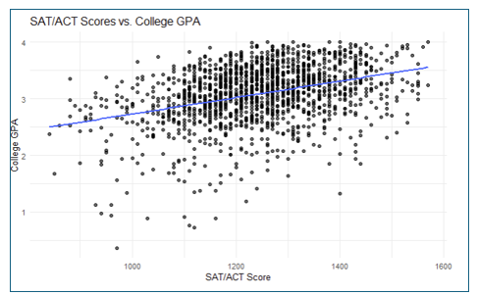
RESULTS: Simple Linear Regression
As SAT/ACT score increases, there is strong evidence that college GPA also increases.
Notes:
The simple linear regression model of SAT/ACT score as a predictor of college GPA indicates a strong positive linear relationship. The effect is statistically significant at the 5% level, so there is strong evidence of a linear relationship between SAT/ACT score and college GPA.

Slide 9
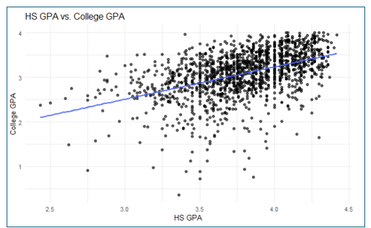
RESULTS: Simple Linear Regression
As high school GPA increases, there is strong evidence that college GPA also increases.
Notes:
The simple linear regression model of high school GPA as a predictor of college GPA indicates a strong positive linear relationship. The effect is statistically significant at the 5% level, so there is strong evidence of a linear relationship between SAT/ACT score and college GPA.

Slide 10
RESULTS: Comparing Models
There is a stronger positive linear relationship between SAT/ACT and college GPA than high school GPA and college GPA
The high school GPA model accounts for 13% of variance in college GPA
The SAT/ACT model accounts for 21.4% of variance, indicating a better fit
Both models account for a relatively low amount of variance, which indicates that other factors contribute to variation in college GPA
Notes:
Comparing the models shows a stronger positive relationship between ACT/SAT and college GPA (1.456) than the relationship between high school GPA and college GPA (0.724).
However, the adjusted R squared values indicate that SAT/ACT accounts for only 13% of variance in college GPA while high school GPA accounts for 21.4% of variance in college GPA. This indicates a better fit for the high school GPA model, but both R squared values are low, which indicates that other factors contribute to variation in college GPA.

Slide 11
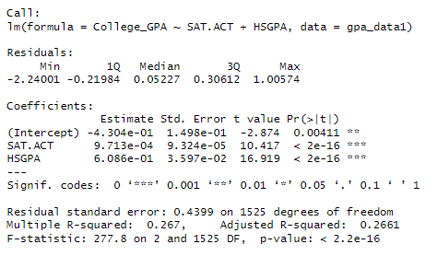
RESULTS: Multiple Regression Model
SAT/ACT scores and high school GPA are statistically significant predictors
Model accounts for ~ 27% of variance in college GPA
ANOVA confirms that adding HS GPS improves the model significantly beyond using SAT/ACT alone
Notes:
The multiple regression model that includes SAT/ACT and high school GPA as predictors shows that both predictors are statistically significant. However, the adjusted R squared value indicates that the multiple regression model explains only about 26% of variance in college GPA. The adjusted R squared value is very close to the R squared value, suggesting that both SAT/ACT and high school GPA contribute meaningfully to the model.
Comparing the multiple regression model to the SAT/ACT only model shows that adding high school GPA improves the model significantly by explaining more variance in college GPA.
ANOVA also confirmed that adding high school GPA improves the model beyond using SAT/ACT alone.

Slide 12

DISCUSSION
SAT/ACT and high school GPA are useful predictors of college GPA
Many additional factors could also impact college GPA
Future analysis could consider the parental education and college type variables
Future research could also consider variables such as parental income, degree type, drug and alcohol consumption, study habits, type of high school, participation in sports, and sleep habits.
image source: https://www.sciencephoto.com/media/1085092/view/portrait-young-female-college-student-studying-in-cafe
Notes:
The analysis shows that SAT/ACT and high school GPA are useful predictors of college GPA.
However many additional factors could also impact college GPA
Future analysis of this data could consider the parental education and college type variables.
Additional research could also consider additional variables that may affect college GPA, such as parental income, degree type, drug and alcohol consumption, study habits, type of high school attended, participation in sports, and sleep habits.

